Slide 1
Operating System a Perspective from Unix (History) CA-2103, Lecture-1, Week-1

Slide 2
Operating System
Operating System can be defined as collection of system calls working as a intermediary between system hardware and user. It provides an environment where user can execute its task happily.
Operating System has full control over the resources such as memory, cpu, monitor and keyboard and offer its services to the end-user as per the convenient of user.
System programs are those programs which can directly interact with the system hardware and control its activities.
It has three Important Objectives:-
Efficiency
Convenient and Flexibility
Example of few Operating System
Unix -1969
Linux -1991
MacOs -2016
Windows -1985

Slide 3
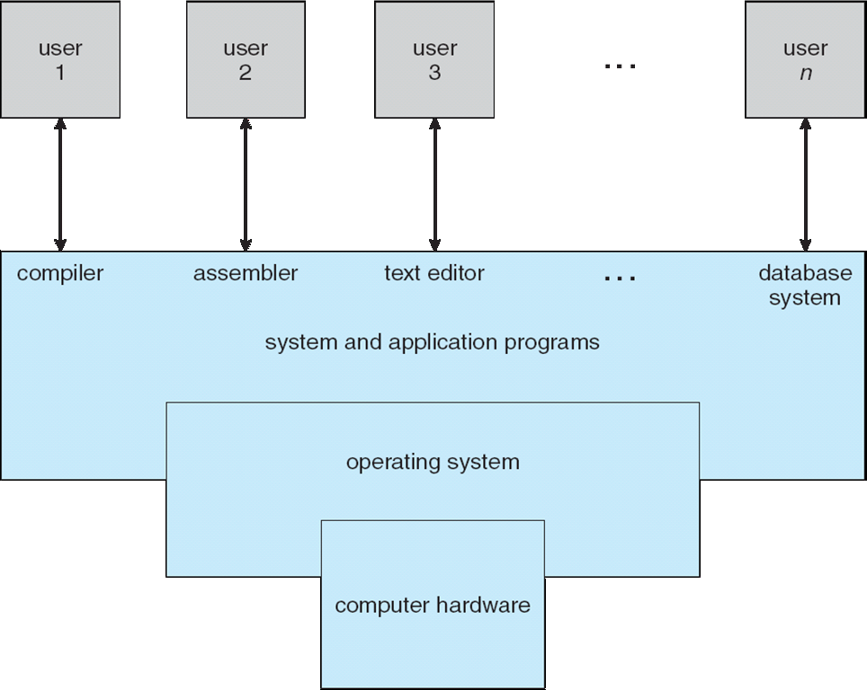
Components of Operating System

Slide 4
Main Services Offered by an Operating System
Following are the common services provided by an operating system:
Program execution.
I/O operations.
File system manipulation.
Communication.
Error detection.
Resource allocation.
Protection.
Scheduling

Slide 5
Computer Startup
bootstrap program is loaded at power-up or reboot
Typically stored in ROM or EPROM, generally known as firmware
Initializes all aspects of the system
Loads operating system kernel and starts execution

Slide 6
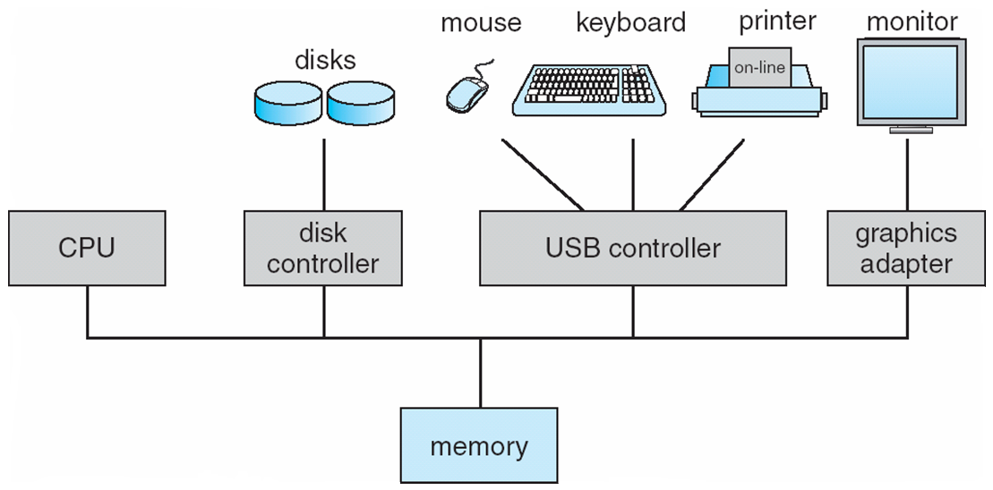
Computer System Organization
Computer-system operation
One or more CPUs, and device controllers connect through a common bus providing access to shared memory
Concurrent execution of CPUs and devices competing for memory cycles

Slide 7
Computer System Operation
I/O devices and the CPU can execute concurrently
Each device controller is in charge of a particular device type
Each device controller has a local buffer
CPU moves data from/to main memory to/from local buffers
I/O is from the device to the local buffer of the controller
Device controller informs CPU that it has finished its operation by causing an interrupt

Slide 8
The Differences UNIX vs LINUX
Linux is only the kernel (everything else that makes up the full operating system is drawn from a number of sources); and it is not UNIX, although it’s clearly UNIX-like
UNIX and Linux have had very different evolutions:
UNIX was developed about 1969 by Thompson, Canaday, and Ritchie, and from the very outset it was designed to be a serious enterprise operating system.
It grew up largely outside of the Intel family of CPUs, although it was later ported to it
By the time Linux first appeared in 1991, UNIX had already become quite fractured: there were many varieties, grouped in two major families; System V arising from the original code at Bell Labs, and BSD, arising from the University of California at Berkeley
Linux, on the other hand, began as a toy operating system only on the x86 architecture; it is doubtful anyone had any idea of how robust it would become or how many architectures it would wind up supporting

Slide 9
Development History
Developed in AT&T Bell Laboratories first version released in1961
PREDECESSOR is Multiplexed Information and Computing Services( Multics)
User need to access main frame computers simultaneously
Text formatting and Typesetting was included first time in 1971
1979 UNIX Vesrsion7 -with 50 Systems calls
Initially UNIX Operating System was very light with limited functionality.
Initially there was no standard. Machine dependent and used mostly in IBM PC.
4.4 BSD UNIX - with 110 System calls
SVR4 - with 120 System calls
Linux 3.2.0 - with 380 System calls
FreeBSD 8.0 - with 450 System calls
By 1993, most commercial vendors changed their variants of Unix to be based on System V with many BSD features added.

Slide 10
UNIX Variants
Sorting out the fractious history and differences among the different UNIXs would be a lengthy task, but by 1991 there were many variants, often tied to a specific hardware platform and vendor:
SGI had IRIX
Sun had SunOS and Solaris
IBM had AIX
Hewlett Packard had HPUX
Cray had UNICOS
DEC had Ultrix
Each one of these manufactures often had several varieties running even on its own universe of hardware
SCO was one of the only variants not arising from a hardware company

Slide 11
GNU
The FSF’s (Free Software Foundation) GNU (GNU’s not UNIX) project developed
freely-distributable versions of many basic utilities, such as tar, ls, grep, etc., and even more important, the gcc compiler and the basic C-library, libc
Linux could not have been born or grown without the availability of tools from the GNU project
We will stay out of the arguments about whether Linux should properly be loosely called GNU/Linux or something similar, but just note that what is often lossly called Linux in fact contains many GNU components; properly speaking, Linux is only the kernel

Slide 12
Correlations (Cont.)
As such it has never been very difficult to port UNIX applications to Linux, unless the application has relied very heavily on certain idiosyncrasies of a particular UNIX implementation
The open nature of the Linux development model has thus far avoided the serious fracturing that took place in UNIX
It is perhaps ironic that the easily legal possibility of having Linux fork into competing versions at any time is perhaps what has prevented it
Many hardware vendors now seriously support Linux on their hardware and the long range future of their own versions of UNIX is often in doubt
It could well be that the Linux plan for world domination is inevitable; at least as far as killing off other UNIX-like operating systems

Slide 13

TTth
Thank You.
The Linux Foundation Internal Use Only
8/14/2017
8

